Slide 1
Alternatives to Traditional Fee-for-Service Models

Slide 2
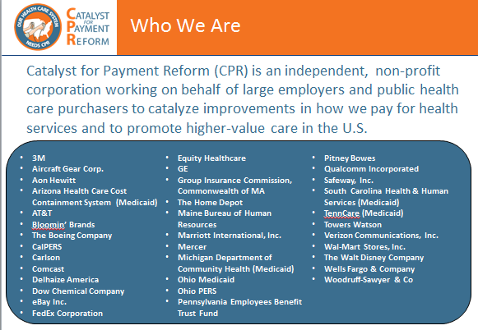
Who We Are and What We Do
Shared Agenda
Payments designed to cut waste or reflect performance
Leverage purchasers and create alignment
  Health plan sourcing, contracting, management and user groups
  Alignment with public sector
Implement Innovations
  Price transparency
  Reference and value pricing
  Maternity payment reform
  Pilots on high-impact areas
  Enhance provider competition
February 25, 2015

Slide 3
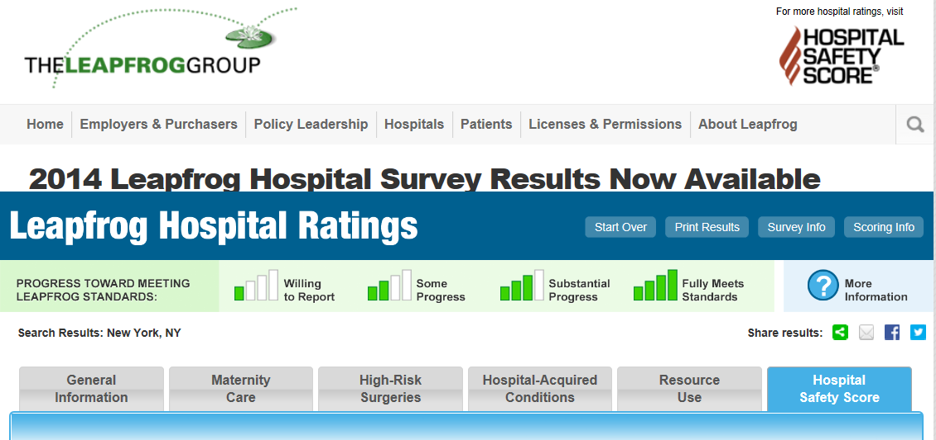
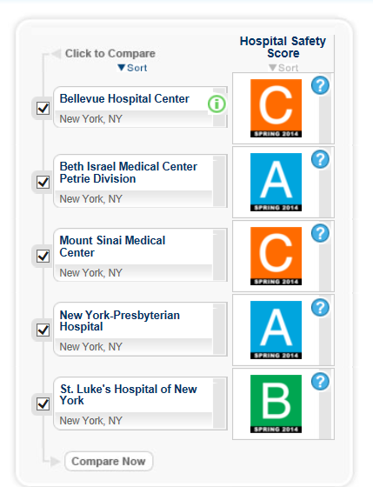
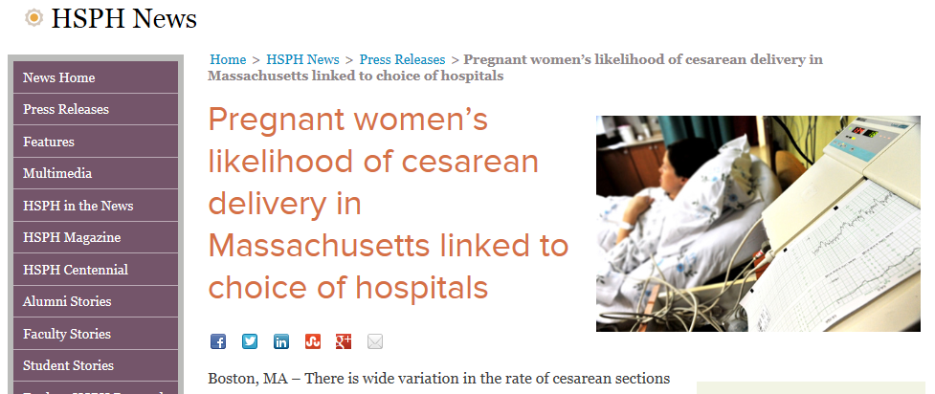
The Challenges to High Value: Variation in Quality and Safety
Huge quality variation
  To Err is Human, 1999: 44,000-98,000 deaths per year
  McGlynn et al, 2003: Patients only get recommended care 55% of the time
February 25, 2015

Slide 4
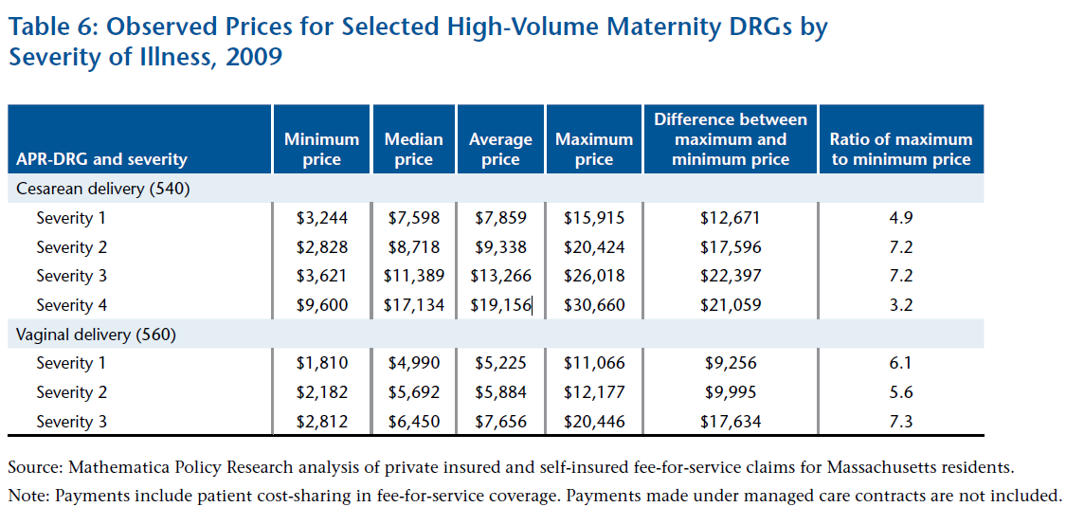
The Challenges to High Value: Variation in Prices and Payments
Prices in the U.S. can vary as much as 700%
*Source: Mathematica
Policy Research
February 25, 2015

Slide 5
Time to Reform Payment & Delivery
Today’s approach to payment allows for poor value; tweaks and reforms may help to improve quality and reduce costs
Health reform included several “Game Changers” and a focus on specific models –is there ‘Irrational exuberance?’
We still know very little about what works – but we know there is no one-size-fits-all model
Most of the time our payments are fee-for service and we pay regardless of quality or outcomes – and there are aspects of care they we don’t pay for at all though we should
Must we start from scratch or can we build on what we have?
February 25, 2015

Slide 6
Payment Model Evolution
BASE PAYMENT MODELS
Fee For Service
Bundled Payment
Global Payment
Charges
Fee Schedule
Per
Diem
DRG
Episode Case Rate
Partial Capitation
Full Capitation
Increasing Accountability, Risk, Provider Collaboration, Resistance, and Complexity
PERFORMANCE-BASED PAYMENT OR PAYMENT DESIGNED TO CUT WASTE (financial upside & downside depends on quality, efficiency, cost, etc.)
February 25, 2015

Slide 7
Upside, Downside, Two-Sided Risk
Type | Examples
Upside only for providers | Physicians Primary Care Medical Home/payment for care coordination or payments for other non-visit functions Payment for shared decision making Payment for nontraditional visits (e.g. e-visits) Hospital-physician gainsharing Pay for Performance Shared savings Hospitals Pay for Performance Shared savings
Downside only for providers | Hospital penalties (e.g. readmissions, Hospital Acquired Conditions, never events, warranties, Length of Stay)
Two-sided risk (both upside and downside) | Bundled payment Global payment/capitation Shared-risk in Accountable Care Organization environment
Most payment reforms built on a fee-for-service chassis
February 25, 2015

Slide 8
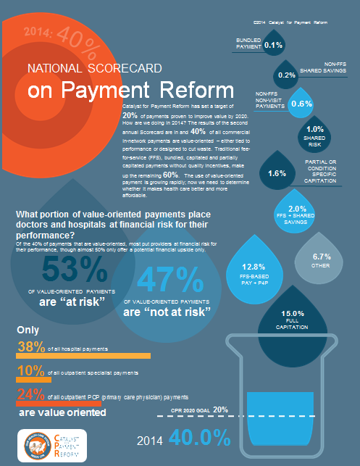
2014 National Scorecard Results
40% of commercial in-network payments are value-oriented; 29% jump from 2013 when it was 11%
53% of the value-oriented
payment is considered “at-risk”
38% of payment to hospitals is value-
oriented
10% of outpatient specialist and 24% of PCP payment is value-oriented
Respondents may be larger than average
health plans in the U.S. and include
HMOs
Scorecard results not statistically reliable, possibly biased upward as survey is voluntary and self-reported
February 25, 2015

Slide 9
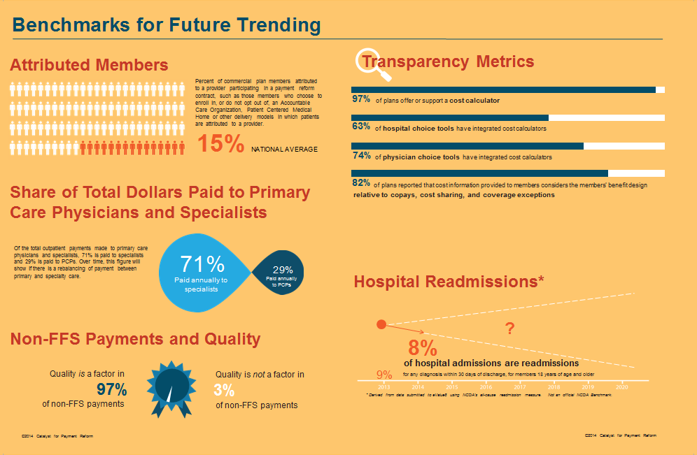
2014 National Scorecard Benchmark Metric Results
www.catalyzepaymentreform.org
February 25, 2015

Slide 10
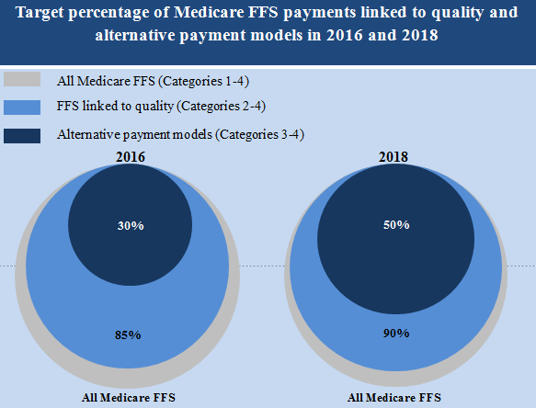
Goals Set by HHS in 2015
Source: http://www.cms.gov/Newsroom/MediaReleaseDatabase/Fact-sheets/2015-Fact-sheets-items/2015-01-26-3.html
www.catalyzepaymentreform.org
February 25, 2015

Slide 11
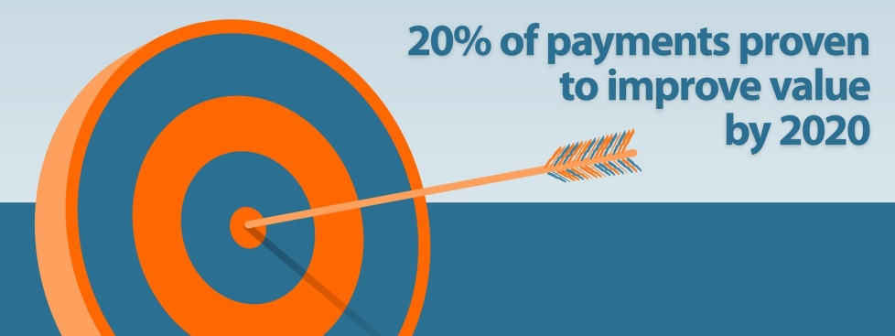

How to Define Success
Are we going to hit our target but miss the bull’s-eye?
CURRENT
FUTURE
We are measuring use of “value-oriented payment” methods.
What happens if we get to 60%, 70%, or 80% by 2020 but value hasn’t improved?
We need to build an evidence base of what works in what context
We need to get to a preponderance of payment flowing through methods proven to produce “value”…
www.catalyzepaymentreform.org
February 25, 2015
Notes:
we think we have right fundamental group and niche we are filling
have to keep up with market, why the bull's eye might change and 2-3 examples of how it might change (consolidation driving prices up, etc.)
what should we do about it?
Go to three pillars and then table
consolidation leading to price
want to do what we are doing but change to preponderance definition
what percent needed to get the delivery system to change?
many value-oriented payments are cost-plus
is 20% enough to incent delivery system to change
other groups (strange bedfellows) proposing 75% for Medicare (SIM - 85%)
tie to proven models

Slide 12
Contact
Suzanne Delbanco, Ph.D., Executive Director sdelbanco@catalyzepaymentreform.org
510-435-2364
February 25, 2015

